Slide 1
Airline Passenger Satisfaction
By: Michael Holthouser

Slide 2
Overview
Business Understanding
Stakeholder
Business Question
Data Understanding
Modeling
Best Model
Evaluation Metric
Feature Visualizations
Recommendations
Future Work

Slide 3
Business Understanding
Stakeholder:
Explorer Airlines
Business Problem:
Explorer Airlines has tasked me to provide prediction analysis on their passenger's satisfaction levels.
Business Question:
What key features do passengers find most important while traveling?

Slide 4
Data Understanding
Gender: male or female
Customer type: regular or non-regular airline customer
Type of travel: the purpose of the passenger's flight (personal or business travel)
Class: business, economy, economy plus
Flight distance: The flight distance of this journey
Inflight wifi service: satisfaction level with Wi-Fi service on board (1-5)
Ease of Online booking: online booking satisfaction rate (1-5)
Food and drink: food and drink satisfaction level (1-5)
Online boarding: satisfaction level with online boarding (1-5)
Seat comfort: seat satisfaction level (1-5)
Inflight entertainment: satisfaction with inflight entertainment (1-5)
On-board service: level of satisfaction with on-board service (1-5)
Leg room service: level of satisfaction with leg room service (1-5)
Baggage handling: level of satisfaction with baggage handling (1-5)
Checkin service: level of satisfaction with checkin service (1-5)
Inflight service: level of satisfaction with inflight service (1-5)
Cleanliness: level of satisfaction with cleanliness (1-5)
Satisfaction: Airline satisfaction level(Satisfaction, neutral or dissatisfaction).

Slide 5
Modeling
Best Model: CatBoost Classifier
97% F1-Score
AUC = 96%
Evaluation Metric:
F1-Score is the harmonic mean of recall and precision.
AUC tells how well the model performs.
Important Features:
Gender female
Baggage handling
Quality of inflight service
Customer type: Returning customer
Seat comfort

Slide 6
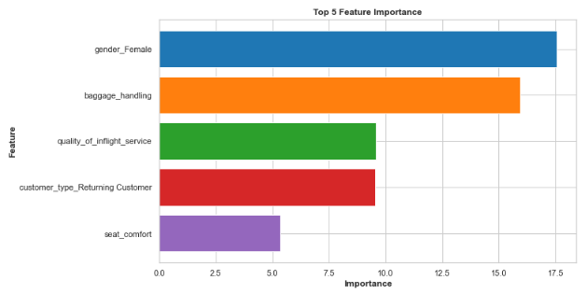
Important Features
Top 5 Important Features:

Slide 7
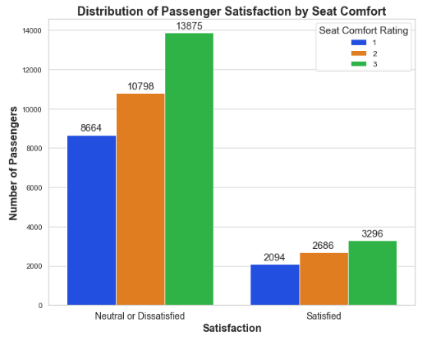
Seat Comfort
Uncomfortable seats mean unhappy passengers.

Slide 8
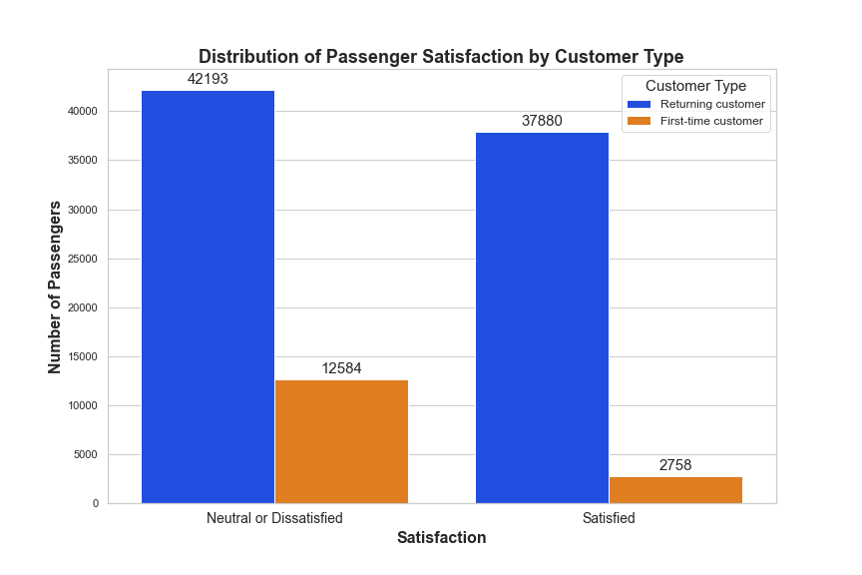
Returning Customers
There were significantly more returning customers than first-time customers in the dataset.
Recommendations:
Offer loyalty programs or rewards to returning customers.
Offer special perks or benefits to returning customers.
Priority boarding.
Free baggage check.
Provide personalized experiences to returning customers.
Offering special promotions based on their past behavior.

Slide 9
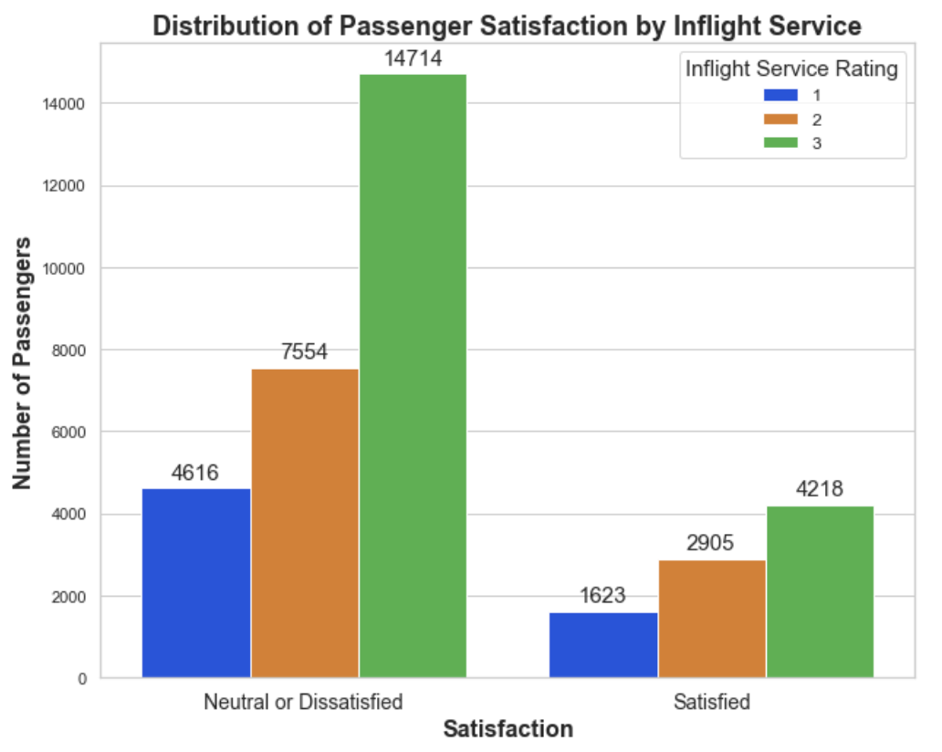
Inflight Service
Poor inflight services will cause passengers to leave neutral or dissatisfied.
Recommendations:
Improve the quality of beverages and meals.
Higher standards.
Cater to dietary needs.
Train attendants to be more attentive to passenger’s needs.
Upgrade inflight entertainment systems, and ensure they work properly before every flight.

Slide 10
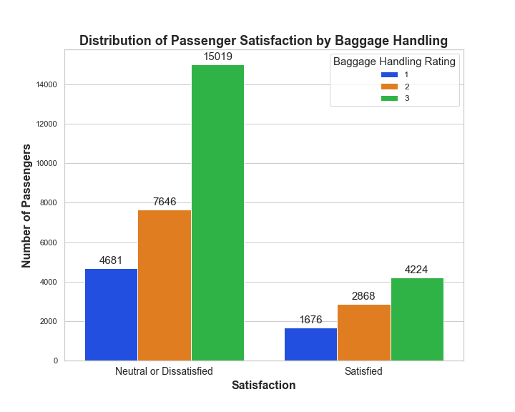
Baggage Handling
Passengers that are unhappy with the care of their luggage are likely to be dissatisfied.
Recommendations:
Invest in luggage tracking technology, to track lost luggage.
New training for baggage handlers to ensure that luggage is handled with care and efficiently delivered to customers.
Increase the speed and efficiency of baggage handling processes.
Baggage check-in.
Loading and unloading bags.
Getting bags to baggage claim.

Slide 11
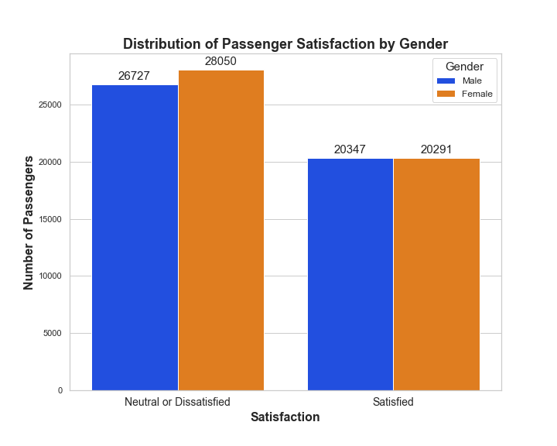
Gender Female
The female gender is more impactful than the male gender for this model.
There are more females than males in this dataset.
Recommendations:
Ensure that their services are inclusive and welcoming to all genders.
Any biases in data collection need to be addressed.
Investigate whether there are any specific areas where female passengers have unique concerns or needs.

Slide 12
Future Work
After adjustments have been made from the recommendations provided, perform another analysis to see if customer satisfaction has improved.
Try different models with different tuning techniques to see if they perform better.
Collect additional data: The dataset used in this analysis only includes a single airline. Collecting data from multiple airlines may provide more insights and make the results more generalizable.

Slide 13


Thank you
Michael Holthouser
Mholthouser.co@gmail.com
https://github.com/MHolthouser1024/Airline-Passenger-Satisfaction.git

